Slide 1
AI APPLICATIONS IN CIVIL AVIATION
TRAINING & RESEARCH

Slide 2
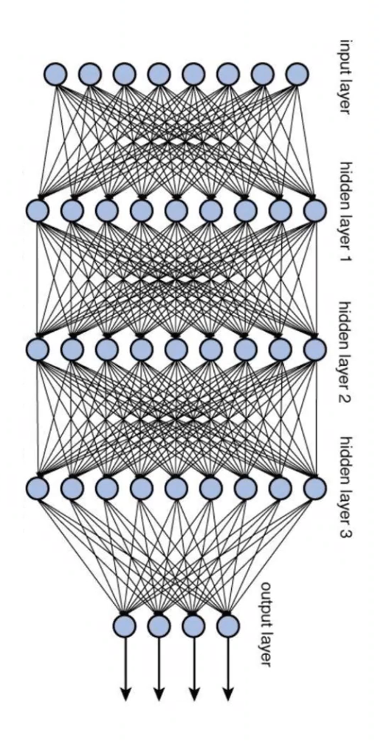
AI
&
CYBERSECURITY
CHALLENGES
AVIATION
APPLICATIONS
INNOVATION
RESEARCH
TRAINING
AI IN PILOT TRAINING

Slide 4
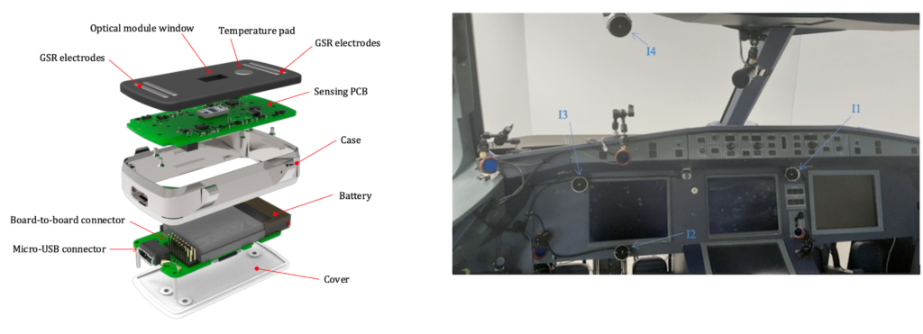
HIPNOSIS
Hardware Implementation of Pilot Non-intrusive Cognitive Sates Identification System
Sensor data fusion:
Wearable Electronics
Flight Deck Cameras
Copyright & Credit

Slide 5
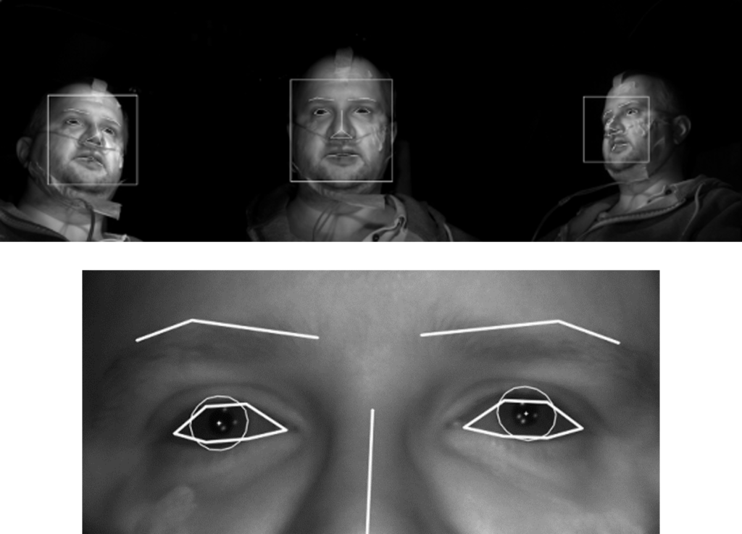
HIPNOSIS
Hardware Implementation of Pilot Non-intrusive Cognitive Sates Identification System
Output Parameters:
Head Pose Estimation
Facial Landmark Detection
IRIS Detection
Copyright & Credit

Slide 6
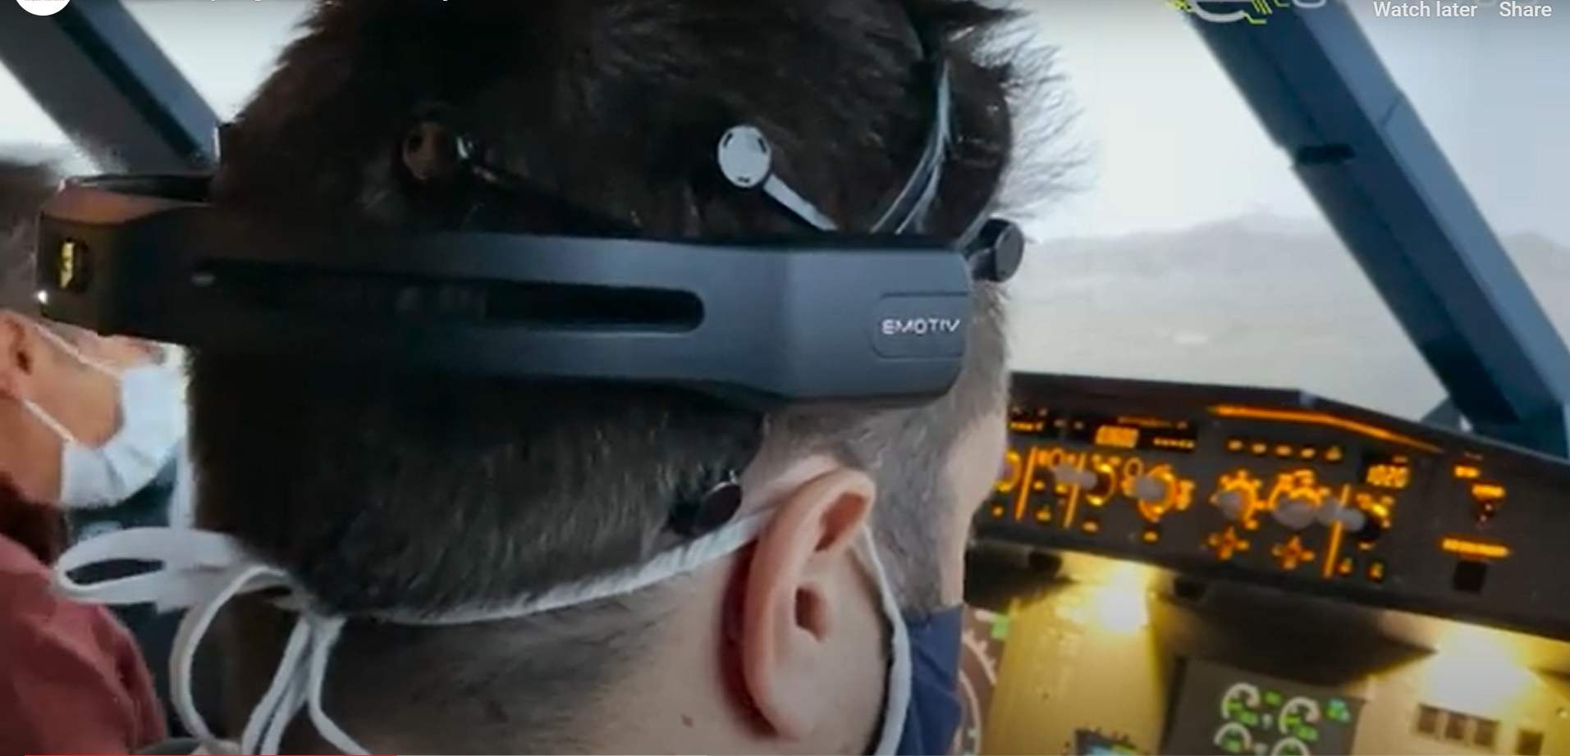
e-Pilots
Evolution of Cockpit Operations Levering on Cognitive Computing Services
Sensor data fusion:
Headset for EEG
Cardiac Sensor for ECG
Copyright & Credit

Slide 7
e-Pilots
Evolution of Cockpit Operations Levering on Cognitive Computing Services
Sensor data fusion:
Headset for EEG
Cardiac Sensor for ECG
Cognitive State Monitoring
Workload Estimation
Workload Modulation
Copyright & Credit

Slide 8
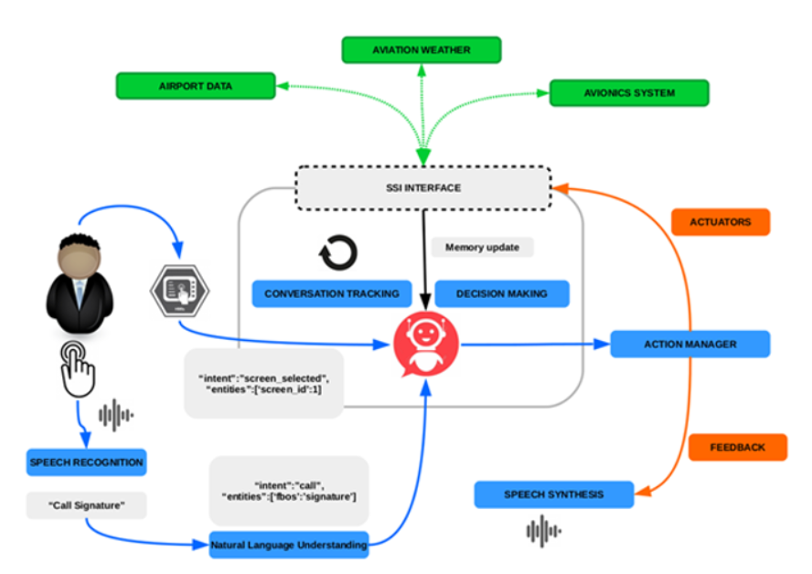
VOICI
Voice Crew Interactions
Intelligent Flight Deck Assistant
TRL 3: Proof of Concept
Copyright & Credit

Slide 9
VOICI
Voice Crew Interactions
Intelligent Flight Deck Assistant
TRL 3: Proof of Concept
Speech Monitoring
Touchscreen Inputs
SOLO
External Information
Decision Making
Action Manager
Copyright & Credit

Slide 10
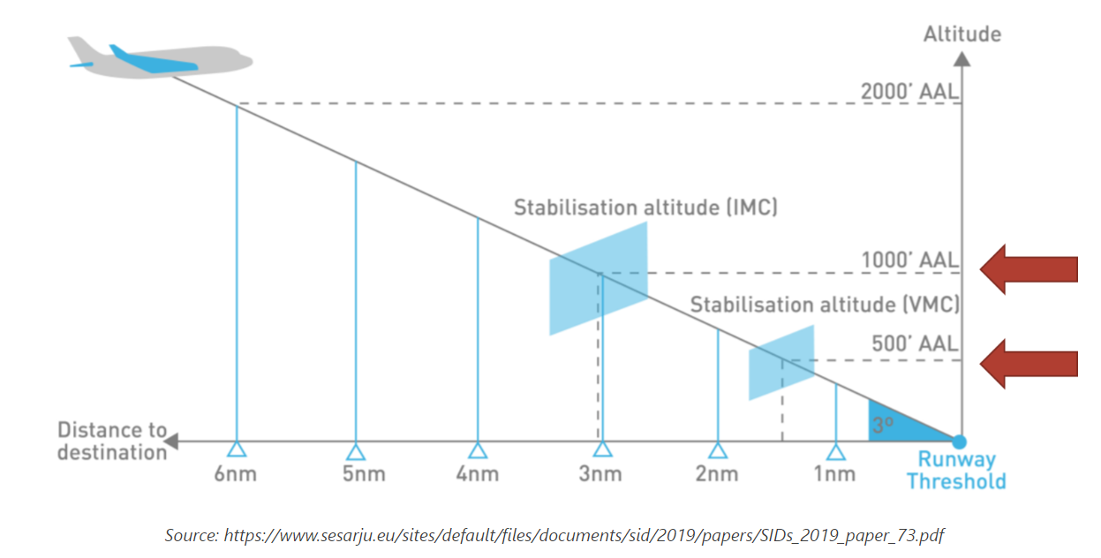
SafeClouds
Machine Learning System
Prediction of Unstable Approach
Pilot Assistance & Decision Support

Slide 11
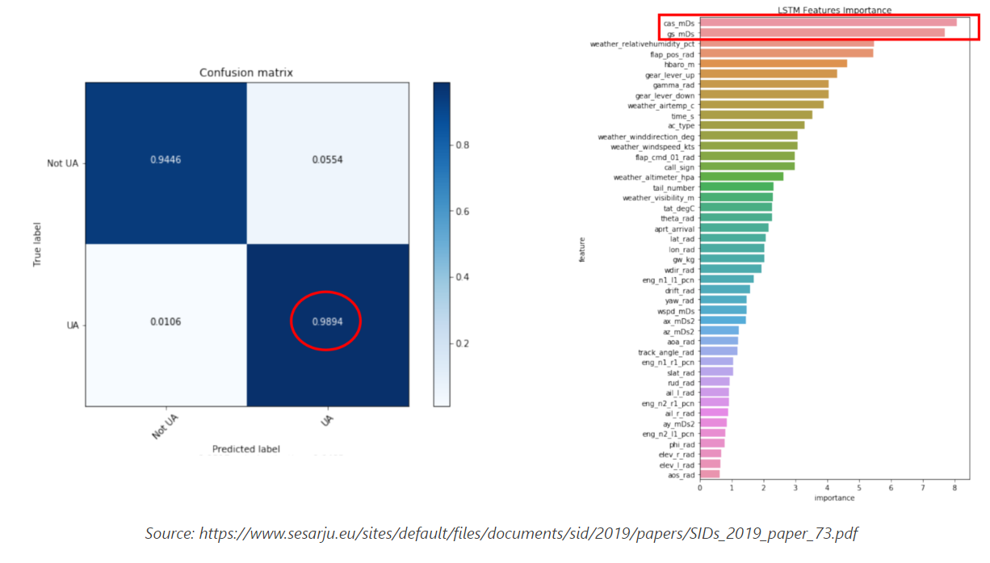
SafeClouds
Machine Learning System
Prediction of Unstable Approach
NOT UA
0.9446
0.0554
UA
0.0106
0.9898
99% Prediction Accuracy
CAS & Ground Speed Factors

Slide 12
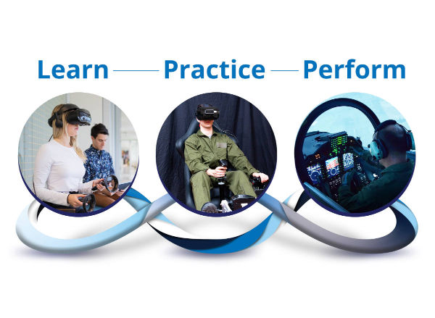
Training-In-Continuum: The QAA Perspective
From the ground up…….

Slide 13
Training-In-Continuum: The Concept
Y
0
L
0

Slide 14
Training-In-Continuum: The Concept
Y
OU
0
NLY
L
0
NCE

Slide 15
Training-In-Continuum: The Concept
Y
OU
0
NLY
L
EARN
0
NCE

Slide 16
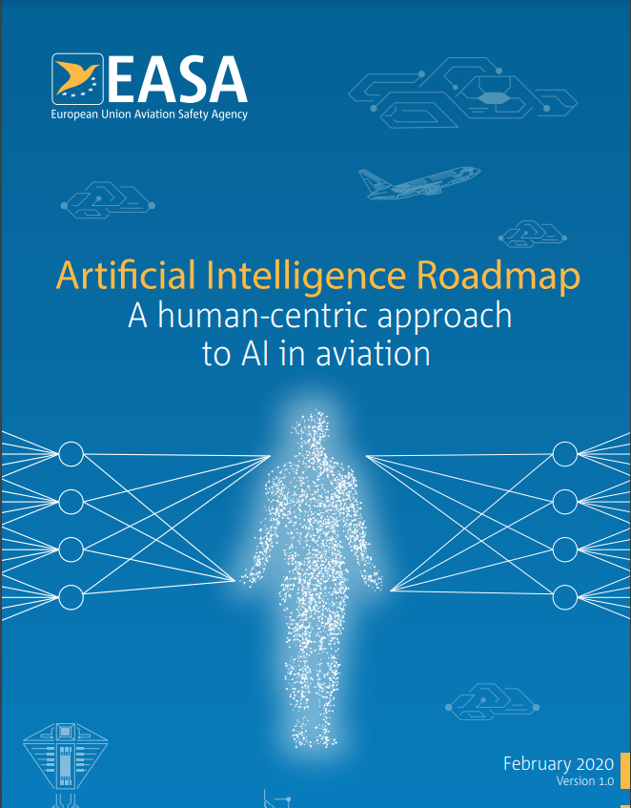
Training-In-Continuum: The Concept
Learning assurance is defined by EASA as
“all of those planned and systemic actions used to substantiate, at an adequate level of confidence, that errors in a data-driven learning process have been identified and corrected such that the system satisfies the applicable requirements at a specified level of performance and provides sufficient generalization and robustness guarantees”.
Regulatory Reference

Slide 17
Training-In-Continuum: The Concept
Learning assurance is defined by EASA as
“all of those planned and systemic actions used to substantiate, at an adequate level of confidence, that errors in a data-driven learning process
in the pilot training process
have been identified and corrected such that the system satisfies the applicable requirements at a specified level of performance and provides sufficient generalization and robustness guarantees”.
Regulatory Reference

Slide 18
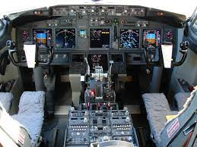
Training-In-Continuum: The Context
P2
P³
P1
P⁴
Professional Pilot Preparatory Phase
Professional Piloting Phase
COMPETENCE

Slide 19
Training-In-Continuum: The Context
P2
P³
P1
P⁴
Professional Pilot Preparatory Phase
Professional Piloting Phase
COMPETENCE
From Day 1 of the ab-initio stage, progressive learning towards understanding
Compliance
KSA
Human Factors
CRM
Application oriented
Guided exploratory learning to connect-the-dots
Learning Facilitation
Student ownership of Learning

Slide 20
Training-In-Continuum: The Context
Professional consolidation within the airline
Transition phase from First Officer to Command
P2
P³
P1
P⁴
Professional Pilot Preparatory Phase
Professional Piloting Phase
COMPETENCE

Slide 21
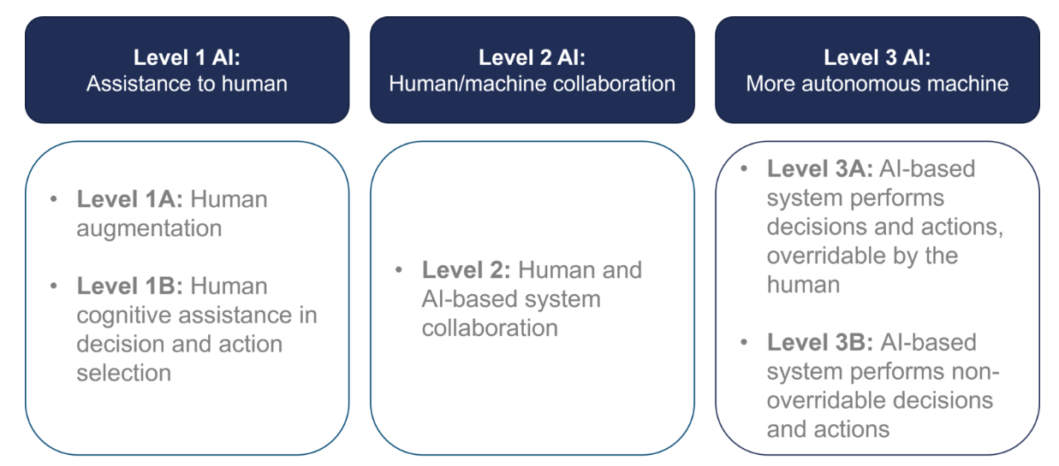
Training-In-Continuum: The Scope of AI

Slide 22
Training-In-Continuum: The Scope of AI

Slide 23
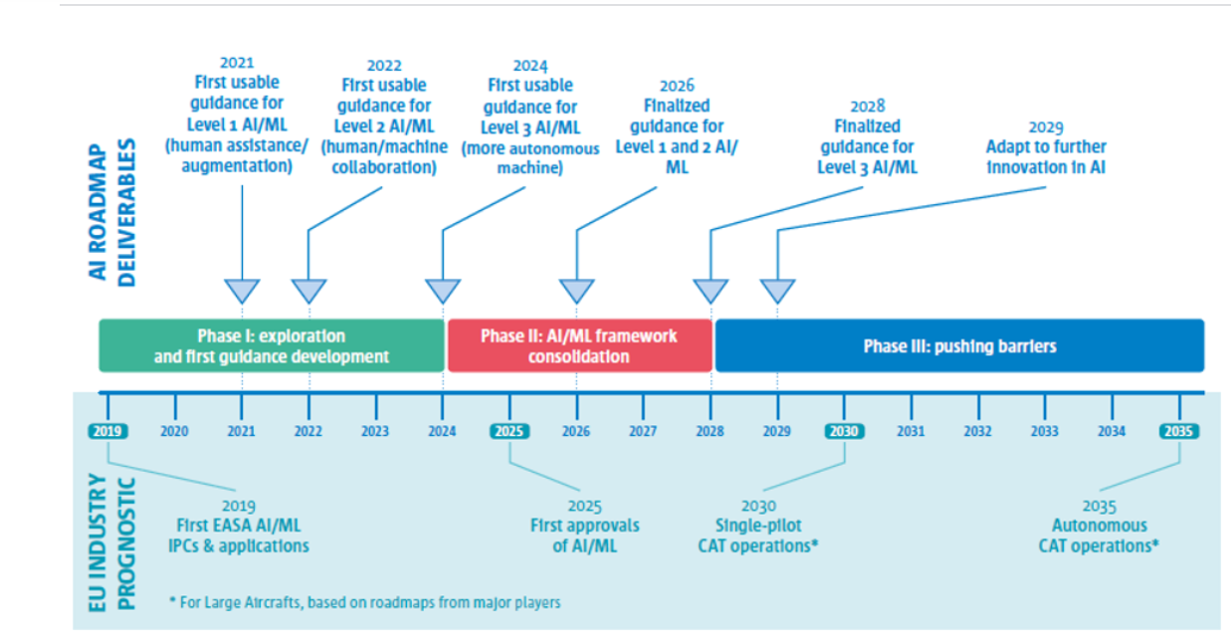
Training-In-Continuum: The Scope of AI

Slide 24
The Scope of AI: Potential Application Areas
PLUS: Pilot Learning Uptake Synthesis
e-KASP: Knowledge Attitude Skills Profiling
GREXAPP: Gradebook Extrusion & Aptitude Prediction
NORMA: Non-normal Operational Risk Metric Analyzer

Slide 25
PLUS: Pilot Learning Uptake Synthesis
Within the overall context of pilot training
Early spotting of uptake issues
Learning Curve Monitoring
Normalization within the population metrics
Archived & Accessible across career span
P2
P³
P1
P⁴
Professional Pilot Preparatory Phase
Professional Piloting Phase
COMPETENCE

Slide 26
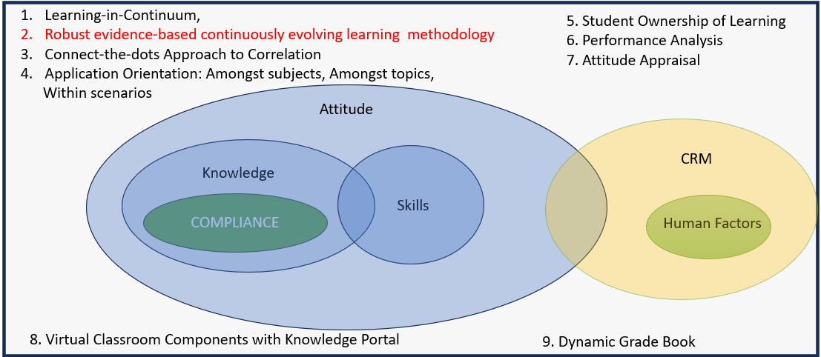
e-KASP
Knowledge Attitude Skills Profiling
GREXAPP
Gradebook Extrusion & Aptitude Prediction
Across all stages of pilot training
Individual Aptitude
ICAO Core Competencies
CRM Profiling

Slide 27
e-KASP
Knowledge Attitude Skills Profiling
Across all stages of pilot training
Individual Aptitude
ICAO Core Competencies
CRM Profiling
Hoover
Compile
Patternize
Normalize
Extrapolate
Predict
GREXAPP
Gradebook Extrusion
&
Aptitude Prediction

Slide 28
NORMA
Non-normal Operational Risk Metric Analyzer
Crew Details
Operating Env
Aircraft Status
MEL?
Weather
Aerodromes
App Aids
FDTL Status
Hoover
Compile
Patternize
Normalize
Extrapolate
Predict

Slide 29
NORMA
Non-normal Operational Risk Metric Analyzer
Crew Details
Operating Env
Aircraft Status
MEL?
Weather
Aerodromes
App Aids
FDTL Status
Crew
Training History
CRM Compatibility
Aircraft & Airline
Incident History
Fleet Records
Airports
Weather
Incident Records
Hoover
Compile
Normalize
Extrapolate
Predict

Slide 30
NORMA
Non-normal Operational Risk Metric Analyzer
Crew Details
Operating Env
Aircraft Status
MEL?
Weather
Aerodromes
App Aids
FDTL Status
Crew
Training History
CRM Compatibility
Aircraft & Airline
Incident History
Fleet Records
Airports
Weather
Incident Records
Hoover
Compile
Patternize
Normalize
Extrapolate
Predict
OPERATIONAL RISK METRIC

Slide 31
The distilled essence of the QAA Experience…

Slide 32
The distilled essence of the QAA Experience…
“Scope of AI Implementation For Training Commences from the Time a Pilot is Lined Up for Takeoff on a Career of Piloting…”

